Slide 1
1. Parameter Sharing and tying 2. Noise Inject at training 3. Dropout 4.Batch Normalization 5. Better Activation functions

Slide 2
Sparse Connectivity
convolution neural networks provide a means for working with inputs of variable size.
The traditional neural networks use matrix multiplication by a matrix of parameters with a separate parameter describing the interaction between each input and output unit.
This means that every input unit is connected to every output unit. Convolution neural networks, however, have sparse connections (also known as sparse weights).

Slide 3
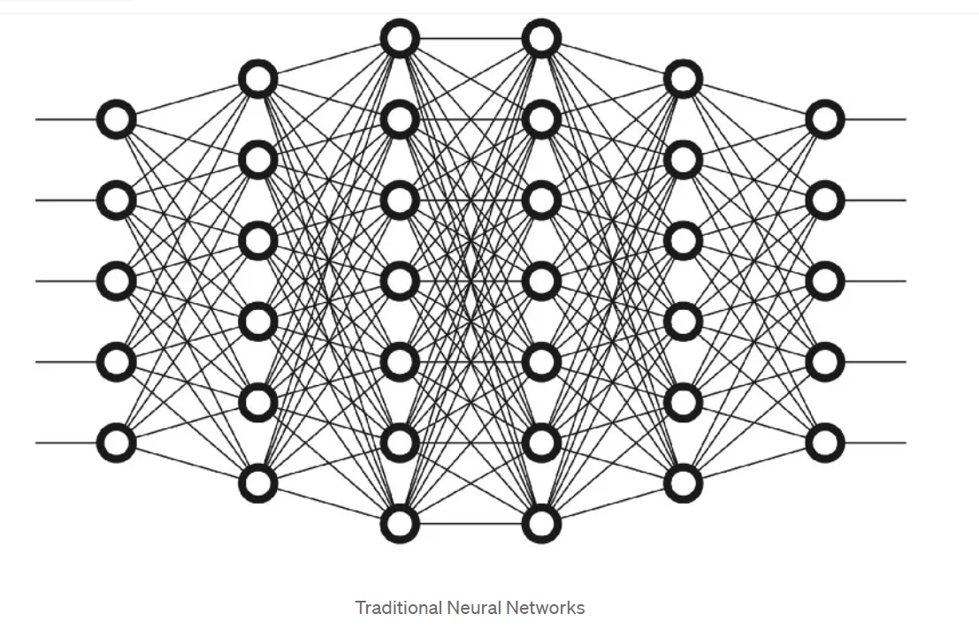
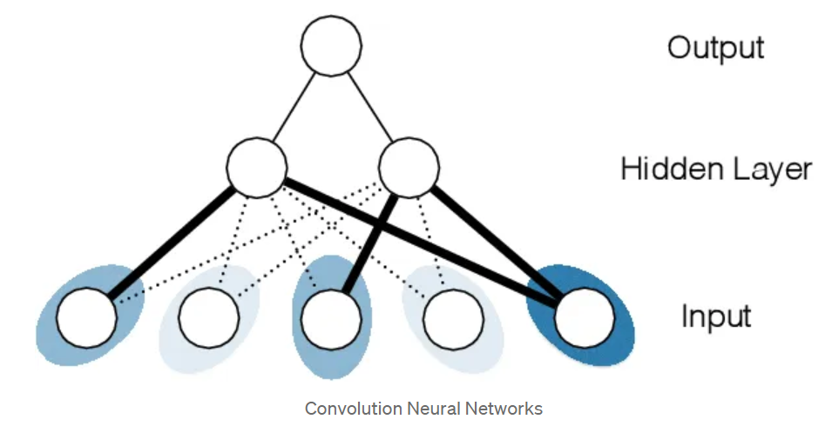

Slide 4
Sparse Connectivity
This is accomplished by making the kernel( a matrix of weights that are multiplied with the input to extract relevant features)smaller than the input image.
The kernels can detect small, meaningful features taking up only a small part of the image. This means that we only need to store a few parameters.
This allows the network to efficiently describe complicated interactions between many variables by constructing interactions from simple building blocks which each describe only sparse interactions.

Slide 5
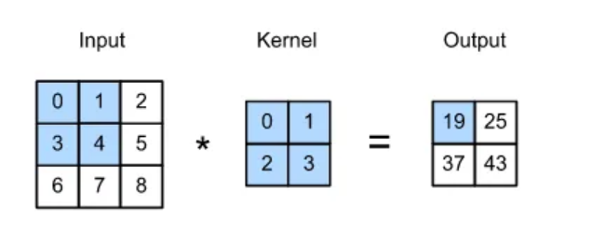
Parameter Sharing
Parameter sharing refers to the use of the same parameters for more than one function in a model.
In a traditional neural net, each element of the neural network has its own weight, i.e. each element of the weight matrix is used only once while computing the output of a layer. It is multiplied by one element of the input and then never revisited.
Notes:
convolution networks have tied weights because the weights applied to one input are tied to the value of the weight applied elsewhere. This means that rather than learning a different set of parameters for each location, we use only one set.

Slide 6
Equivariance Representation
parameter sharing causes the networks to have a property called equivariance.
To say a function is equivariant means that if the input changes, the output changes in the same way.
When processing time series data, convolution produces a sort of timeline of when different features appear in the input. If we move an event later in time, the exact same representation of it will appear in the output, just later in time.
for images, convolution creates a 2-D map of where certain features appear in the input. If we move the object in the input, it will move by the same amount in the output. This is useful when we know that some function of the same number of pixels is useful when applied to multiple input locations.

Slide 7
Parameter tying
a regularization technique.
We divide the parameters or weights of a machine learning model into groups by leveraging prior knowledge, and all parameters in each group are constrained to take the same value.
In simple terms, we want to express that specific parameter should be close to each other.
there might be situations where we might have some prior knowledge on the kind of dependencies that the model should encode.

Slide 8
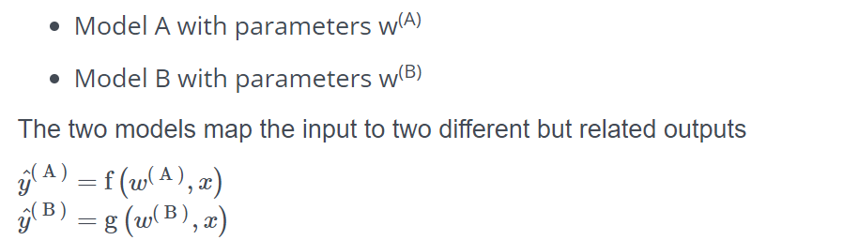
Parameter tying
Two models perform the same classification task (with the same set of classes) but with different input data.

Slide 9
Parameter tying
Some standard regularisers like l1 and l2 penalize model parameters for deviating from the fixed value of zero.
One of the side effects of Lasso or group-Lasso regularization in learning a Deep Neural Networks is that there is a possibility that many of the parameters may become zero.
Thus, reducing the amount of memory required to store the model and lowering the computational cost of applying it

Slide 10
Noise injection
concept of overfitting is that the model is overtrained on the given input samples.
leads to around 100% accuracy of the model.
But this results show less accuracy in the test data.
In order to reduce this problem, we have methodologies like generalization techniques. Along with them, the new concept of noise injection is added to reduce the problem of overfitting.

Slide 11
Noise injection
to increase the size of the dataset by upsampling the whole dataset, either collecting the new data or adding some noise or unwanted data.
The concept of collecting a new data sample and adding it to the dataset is a routine and effort-needed task.
Thus the concept of noise injection to the dataset is required and developed. The type of noise you are going to add to the dataset is purely based on the actual dataset.

Slide 12
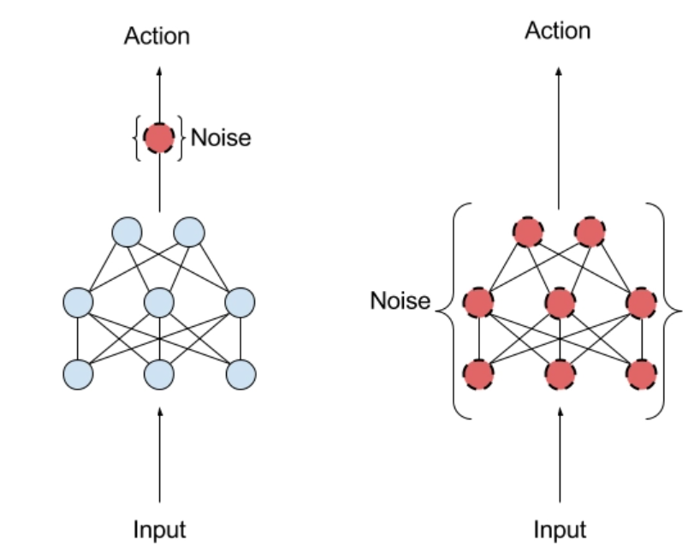
Noise injection at training

Slide 13
Noise injection
adding noise expands the training dataset size.
Each time when a training sample is exposed to the model, some random noise is added to the input variables making them different every time it is exposed to the model.
this way, adding noise to input samples is a simple form of “data augmentation”. Thus the noise addition makes the model not memorize the samples much efficiently, resulting in a smooth mapping function.

Slide 14
Dropout
In machine learning projects, overfitting and underfitting are common issues.
Regularization techniques address these problems by adjusting model complexity, such as using dropout or adjusting hyperparameters, ensuring the model fits the data appropriately without memorizing noise
Picture depicts, applying a dropout regularization in deep learning on the second hidden layer of a neuron network.

Slide 15
Dropout
“dropout” refers to the practice of disregarding certain nodes in a layer at random during training.
A dropout regularization in deep learning is a regularization approach that prevents overfitting by ensuring that no units are codependent with one another.
During training, the network randomly ignores or drops some layer outputs. This changes the layer’s appearance and connectivity compared to the preceding layer.
Dropout is implemented per layer in a neural network. It works with the vast majority of layers, including dense, fully connected, convolutional, and recurrent layers such as the long short-term memory network layer.
Dropout can occur on any or all of the network’s hidden layers as well as the visible or input layer. It is not used on the output layer.

Slide 16
Dropout implementation
Using the torch. nn, you can easily add a Dropout in machine learning to your PyTorch models.
self.dropout = nn.Dropout(0.25)

Slide 17
Better Activation functions
They determine the output of a neuron, which then propagates forward to the next layer of neurons. The activation function essentially decides whether a neuron should be "activated" or not based on the input it receives.
ReLU (Rectified Linear Unit) Activation Function
Leaky ReLU Activation Function
ELU (Exponential Linear Unit) Activation Function
Tanh (Hyperbolic Tangent) Activation Function
Softmax Activation Function

Slide 18
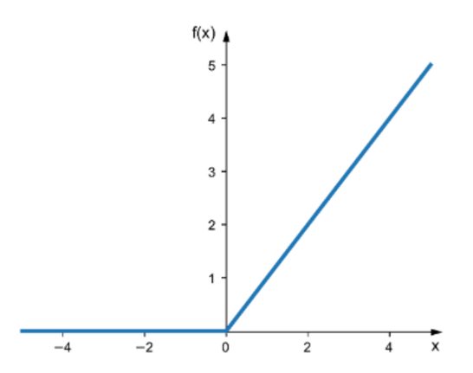
ReLU (Rectified Linear Unit) Activation Function
It is a simple function that returns the input if it is positive, and zero otherwise. ReLU is computationally efficient, and it is easy to implement.
It has been shown to work well in deep neural networks, particularly for image classification tasks.
it can speed up the convergence of stochastic gradient descent (SGD), which is an optimization algorithm used in deep learning. However, ReLU is not suitable for all types of neural networks, such as those with a large number of negative inputs.

Slide 19
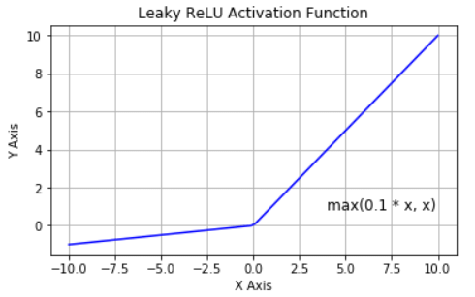
Leaky ReLU Activation Function
an extension of the ReLU activation function.
It is similar to ReLU, but instead of returning zero for negative inputs, it returns a small negative value.
This helps to avoid the "dying ReLU" problem, where some neurons can become permanently inactive during training.
The Leaky ReLU activation function has been shown to perform better than ReLU in some deep neural network architectures.
It is particularly useful in networks with a large number of negative inputs. However, it can be slower to compute than ReLU.

Slide 20
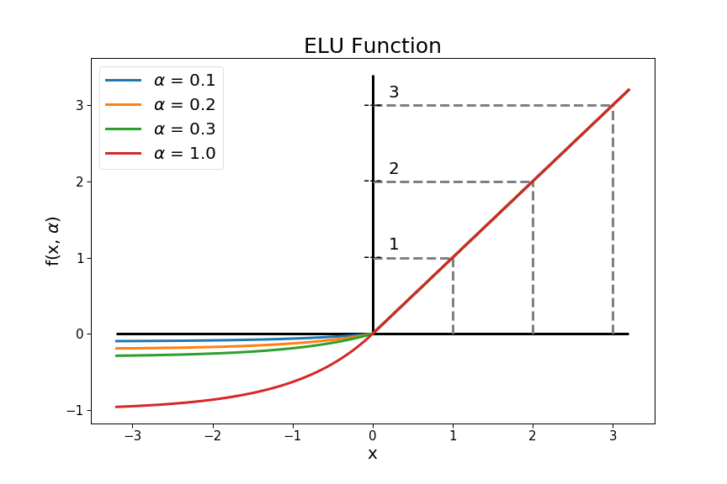
ELU (Exponential Linear Unit) Activation Function
ELU is a more complex activation function than ReLU or Leaky ReLU. It returns the input if it is positive, and an exponential function of the input minus one otherwise.
The exponential function helps to avoid the "dead neurons" problem that can occur with ReLU.
It has a smooth curve, which makes it easier to optimize than other activation functions. However, it can be slower to compute than ReLU and Leaky ReLU.

Slide 21
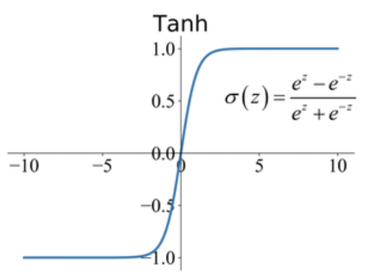
Tanh (Hyperbolic Tangent) Activation Function
Tanh is a non-linear activation function that returns values between -1 and 1. It is similar to the sigmoid activation function, but it is centered at zero, which makes it more symmetric.
Tanh is useful in some types of neural networks, such as those used for language modeling and speech recognition.
it can suffer from the same vanishing gradient problem that can occur with sigmoid activation functions.

Slide 22
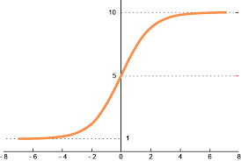
Softmax Activation Function
Softmax is a special type of activation function used in the output layer of a neural network for multi-class classification tasks.
It returns a probability distribution over the possible classes, with the sum of the probabilities equal to one.
Softmax is useful for tasks such as image recognition, where the network needs to classify an image into one of several possible categories.
it can be sensitive to outliers in the input data.

Slide 23
Batch Normalisation
Batch normalization is a supervised learning method for normalizing the interlayer outputs of a neural network. As a result, the next layer receives a “reset” of the output distribution from the preceding layer, allowing it to analyze the data more effectively.
Since normalization guarantees that no activation value is too high or too low, and since it enables each layer to learn independently from the others, this strategy leads to quicker learning rates.
By standardizing inputs, the “dropout” rate (the amount of information lost between processing stages) may be decreased. That ultimately leads to a vast increase in precision

Slide 24
How does batch normalization work?
a technique used to improve the performance of a deep learning network by first removing the batch mean and then splitting it by the batch standard deviation.
Stochastic gradient descent is used to rectify this standardization if the loss function is too big, by shifting or scaling the outputs by a parameter, which in turn affects the accuracy of the weights in the following layer.
When applied to a layer, batch normalization multiplies its output by a standard deviation parameter (gamma) and adds a mean parameter (beta) to it as a secondary trainable parameter. Data may be “denormalized” by adjusting just these two weights for each output.
The goal of batch normalization is to stabilize the training process and improve the generalization ability of the model. It can also help to reduce the need for careful initialization of the model’s weights and can allow the use of higher learning rates, which can speed up the training process.

